Slide 1
Face Recognition
&
Style Recognition
Nora(Tianyang) Han
Keyu Lu

Slide 2
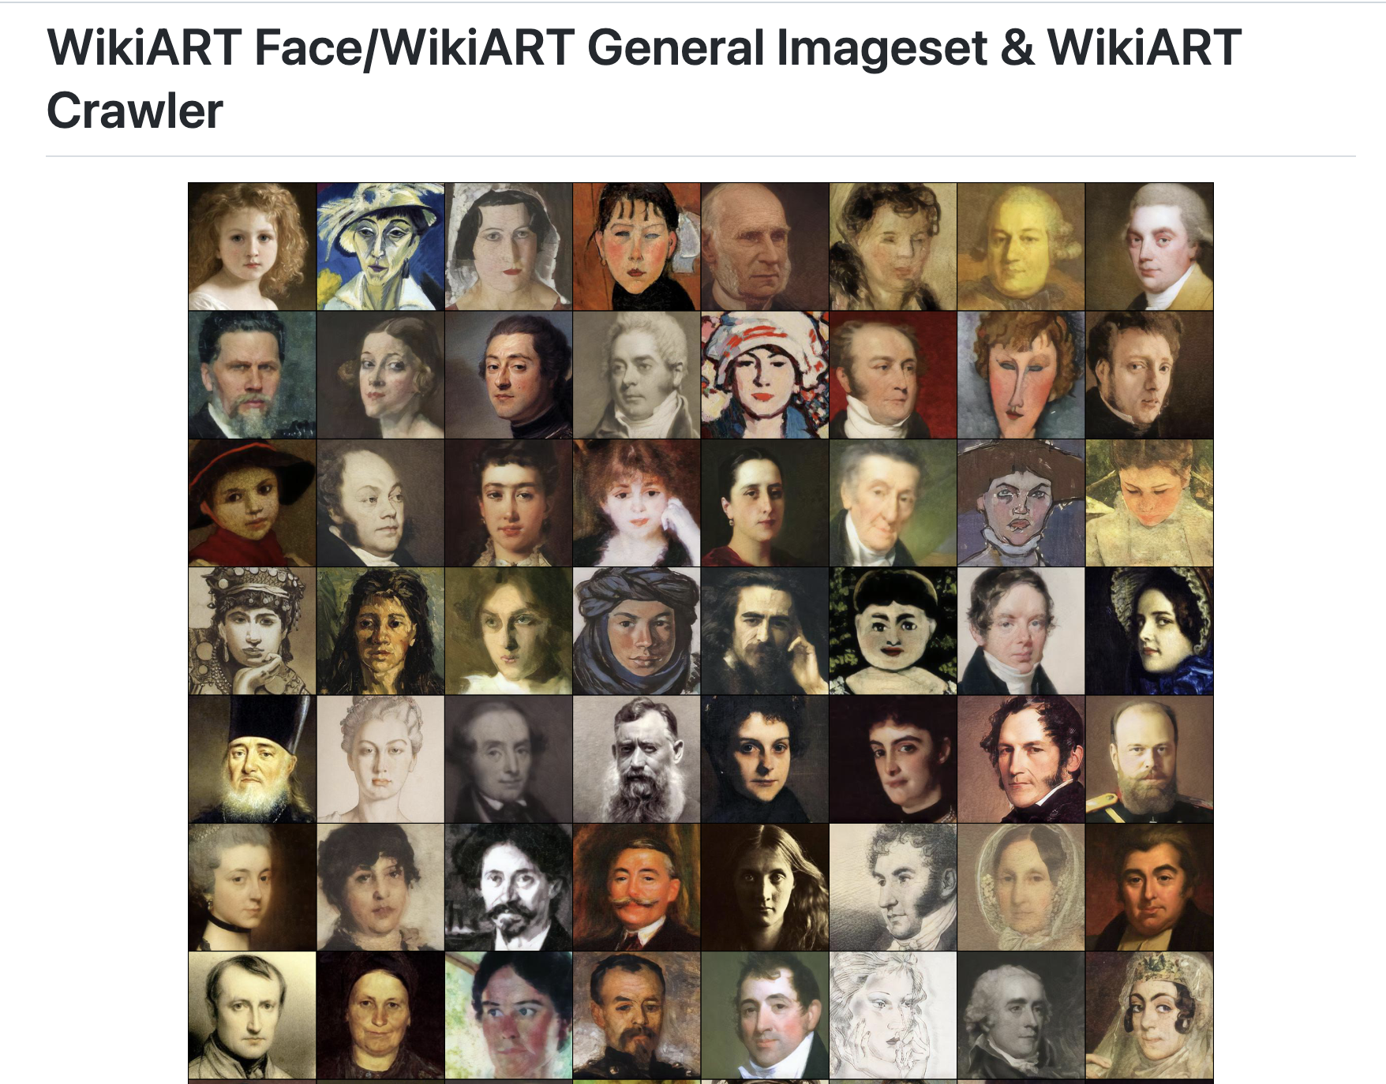
Data Set (Painting)
https://github.com/asahi417/wikiart-image-dataset
For paintings, we are using the WikiArt imageset

Slide 3
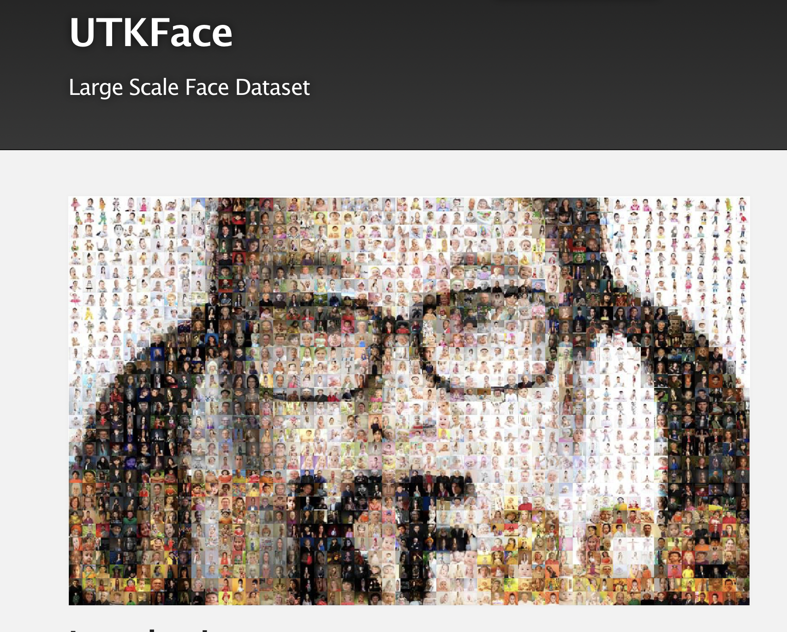
Data Set (Natural Faces)
https://susanqq.github.io/UTKFace/
For natural faces, we chose to use images that include characters between age of 20-22, the dataset we chose are mostly 21 years old.

Slide 4
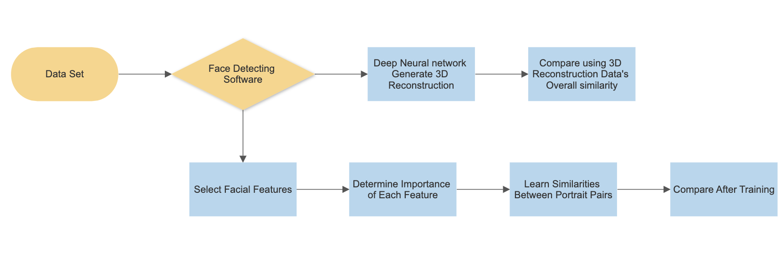
Experiment Design
We are focusing on the first stream in this exhibition.

Slide 5
Hypothesis
We are expecting the t-SNE plot our algorithm is creating to show different clusters of facial data analysis for artists with different styles with the following evaluation matrices:
The more scattered the clusters are, the smaller the similarity correlation between the compared clusters is
The more united one specific cluster is, the higher the similarity correlation within this one cluster is

Slide 6
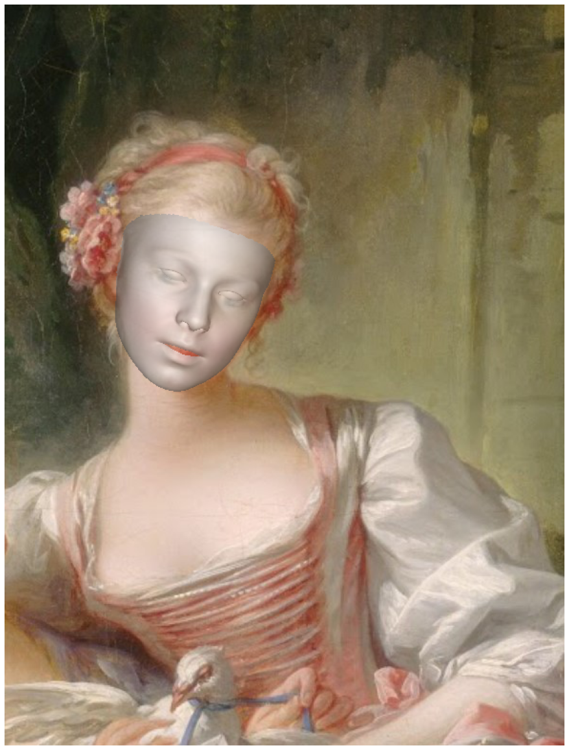
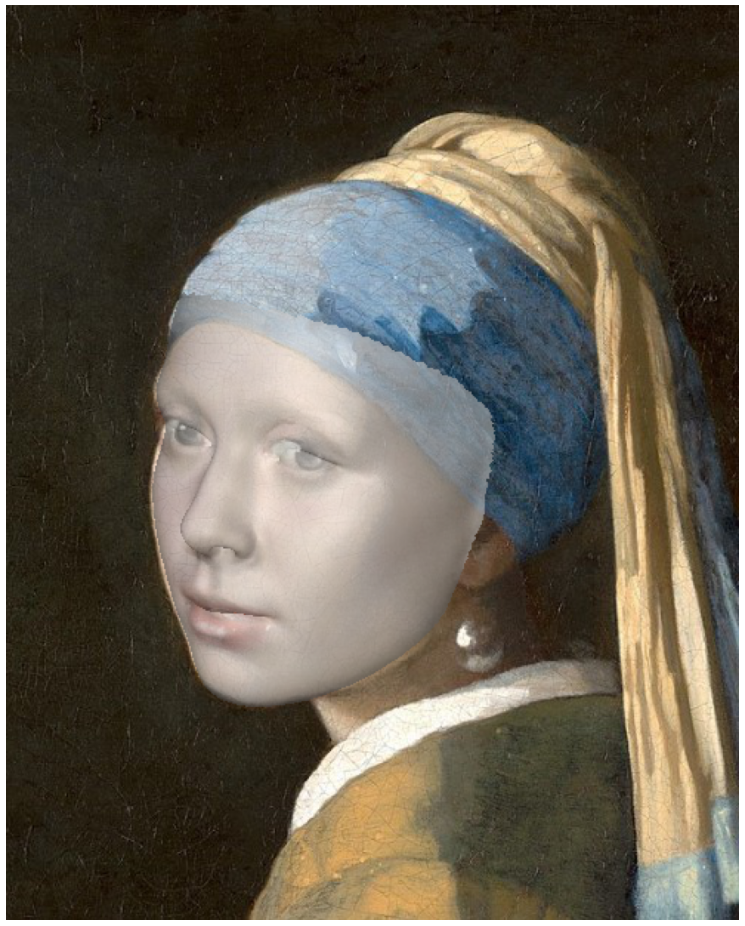
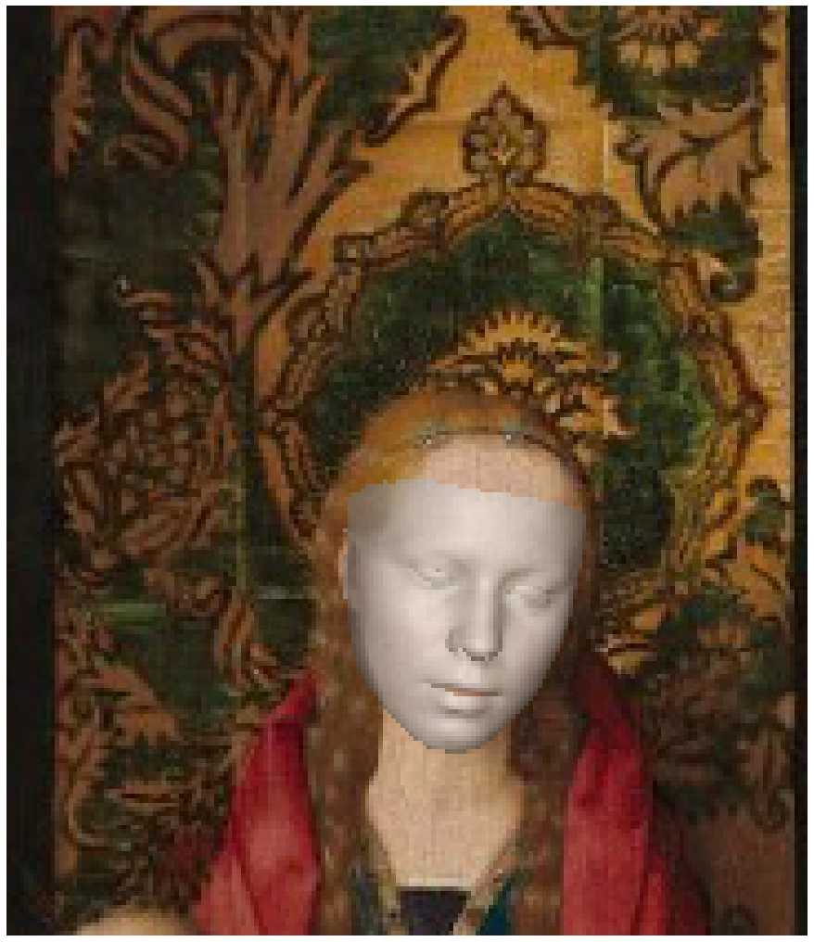
Implementation(demonstration of 3d reconstruction software)

Slide 7
Implementation
We implemented our program in google colab notebook with Python
The face Recognition & 3d reconstruction software we used is from: https://github.com/cleardusk/3DDFA_V2.git
We have attached the link for our colab notebook with all our technical implementation available and detailed guide on how to run our program in the following slide

Slide 8
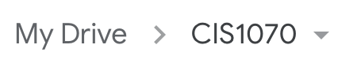
How to Run Our Google Colab Notebook
Our folder containing Datasets and colab notebook: CIS1070
Click on the link above, then click on “CIS1070” on the upper left
Choose “Add shortcut to Drive” and then choose “My Drive”
Go to the folder “colab_final”
Open the google colab notebook file “cis1070_final_project.ipynb”
Go to “file”→ “save a copy in drive”
Run all the code in the copied file and change perplexity (grid [20]), artists(grid [7]) as you like to see different results

Slide 9
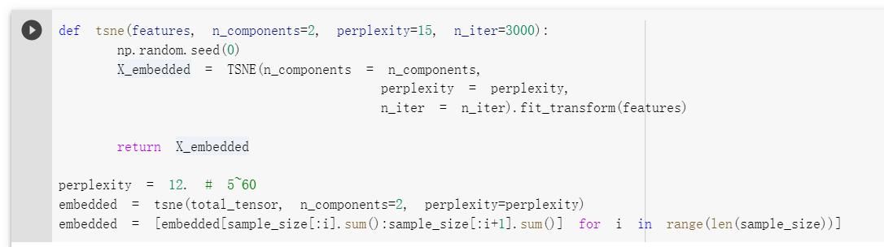
Results based on different perplexity number
We based out analysis on t-SNE and we used the following parameters to analyze t-SNE plot which includes perplexity number and n = 3000

Slide 10
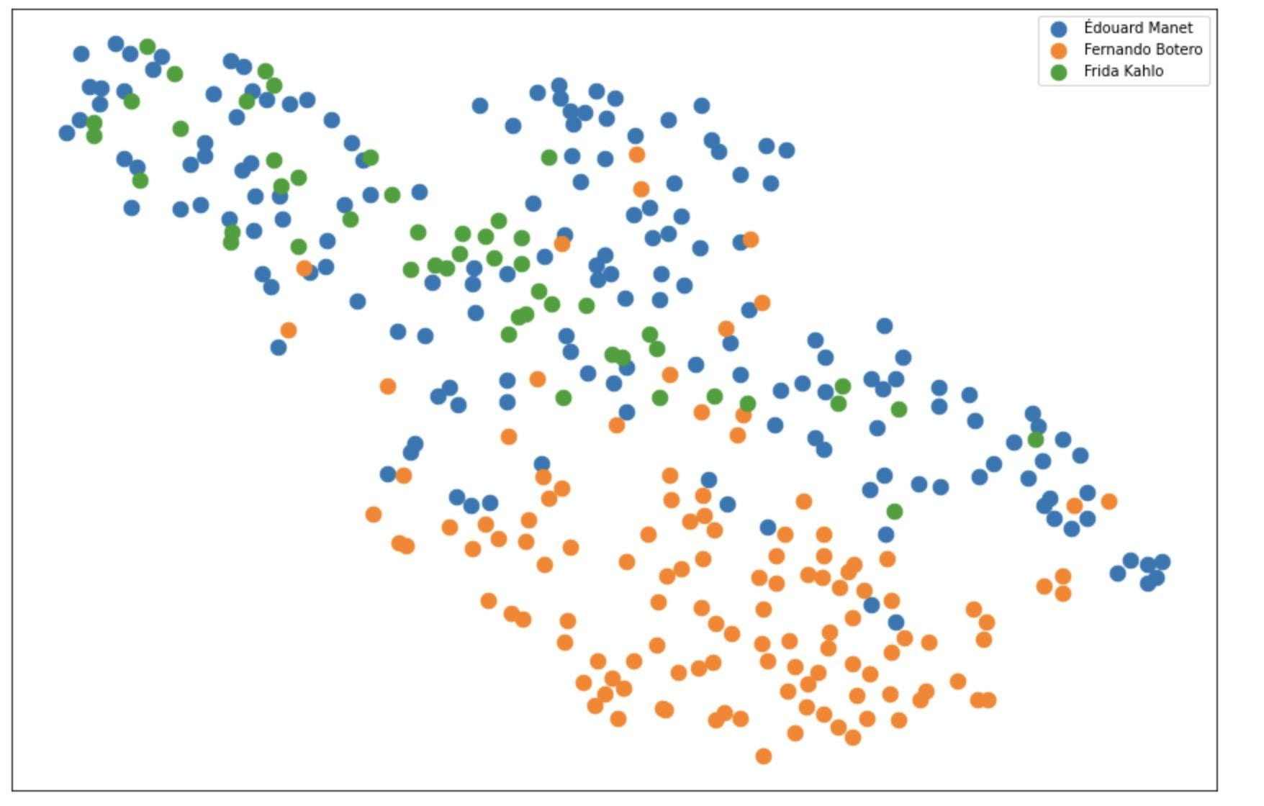
Perplexity = 28
From this graph based on our analysis matrices, we can see that the work of Fernando Botero is less similar to the two other artists: Manet and Kahlo

Slide 11
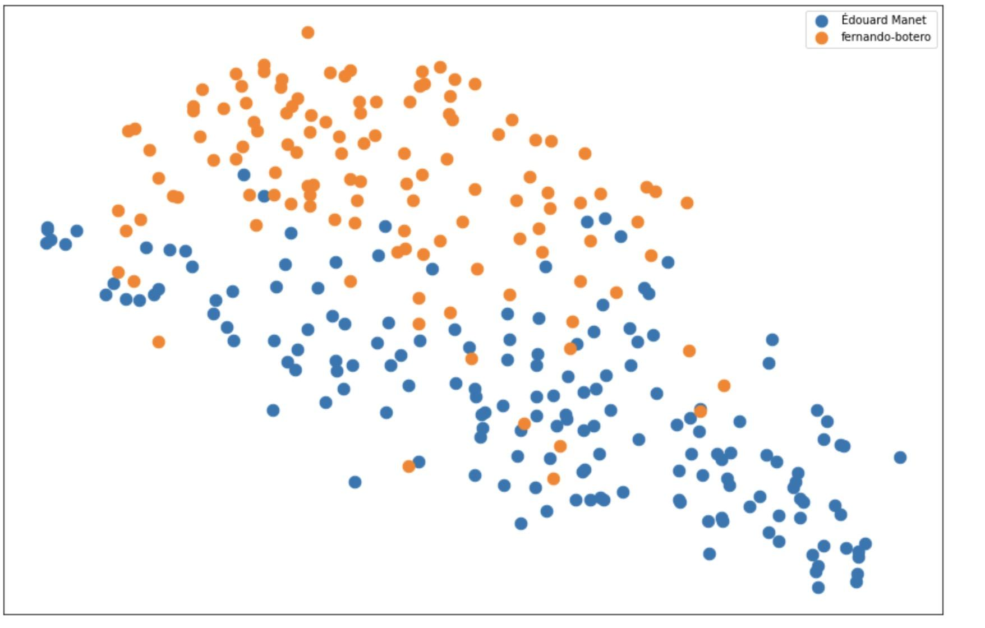
Perplexity = 60
This comparison between Manet and Botero with a higher perplexity number helps us see a way to further demonstrate the strong differentiation in the artistic style of Manet and Botero’s portrait art

Slide 12
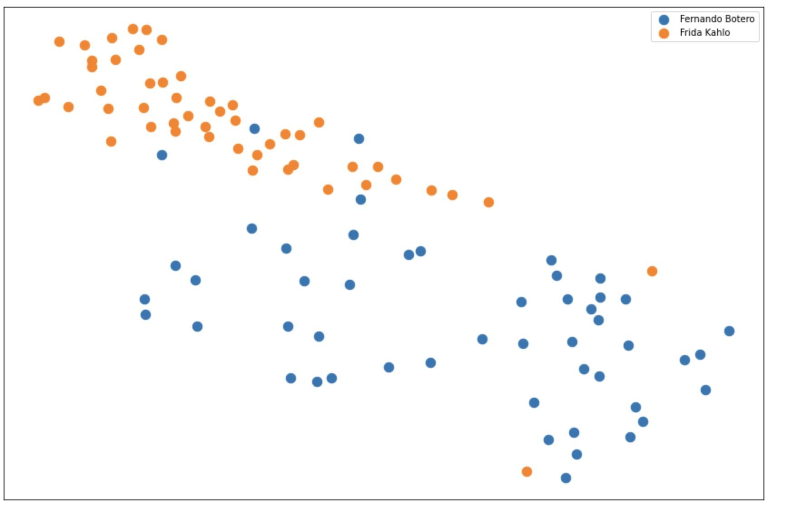
Perplexity = 25, each artists with 50 faces plotted
This comparison between Kahlo and Botero with perplexity 25 and equal yet smaller set of data of 50 faces, this helps us see a comparison of data plotting between different data sizes in our implementation of t-SNE plotting

Slide 13
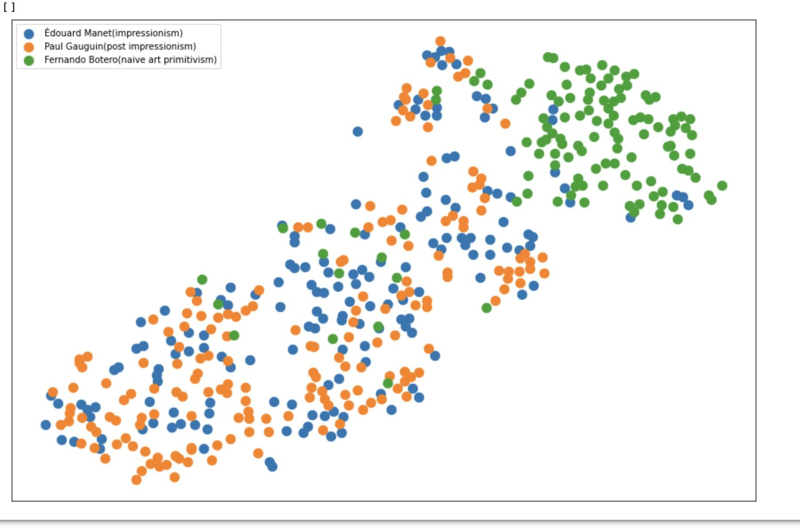
Perplexity = 25
This comparison shows Botero as an artist show strong different style with least overlapping plotting while having the two impressionists Manet and Gauguin share way more overlapped area

Slide 14
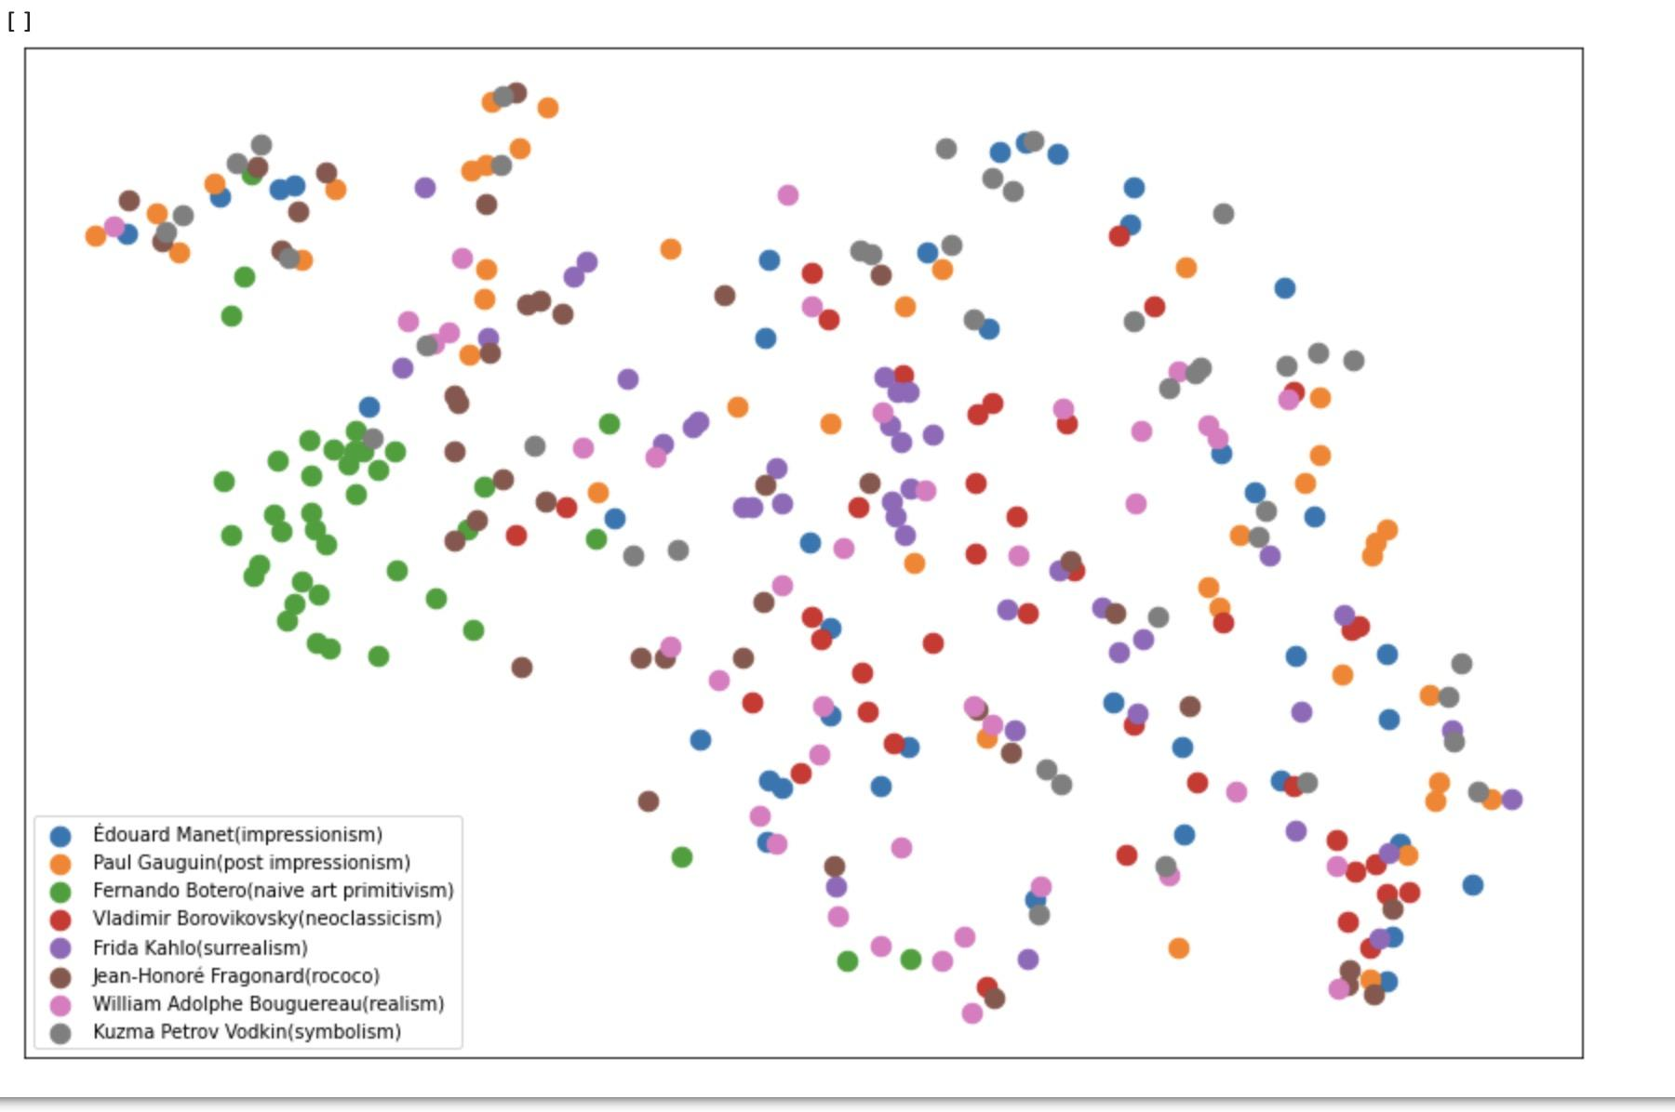
Perplexity = 25
This comparison continues to show Botero as an artist with strong different style among all other artists and some artists are showing a greater span in their artistic styles than the others with less clustered art works

Slide 15
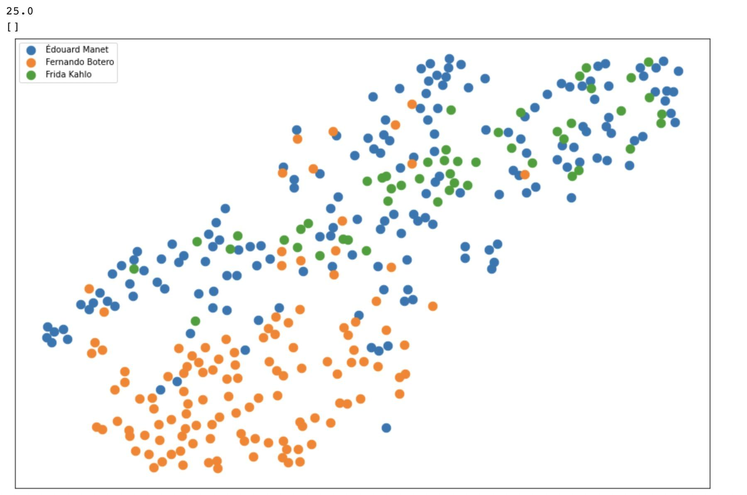
Perplexity = 25
t-SNE plotting of Manet, Botero and Kahlo with perplexity = 25

Slide 16
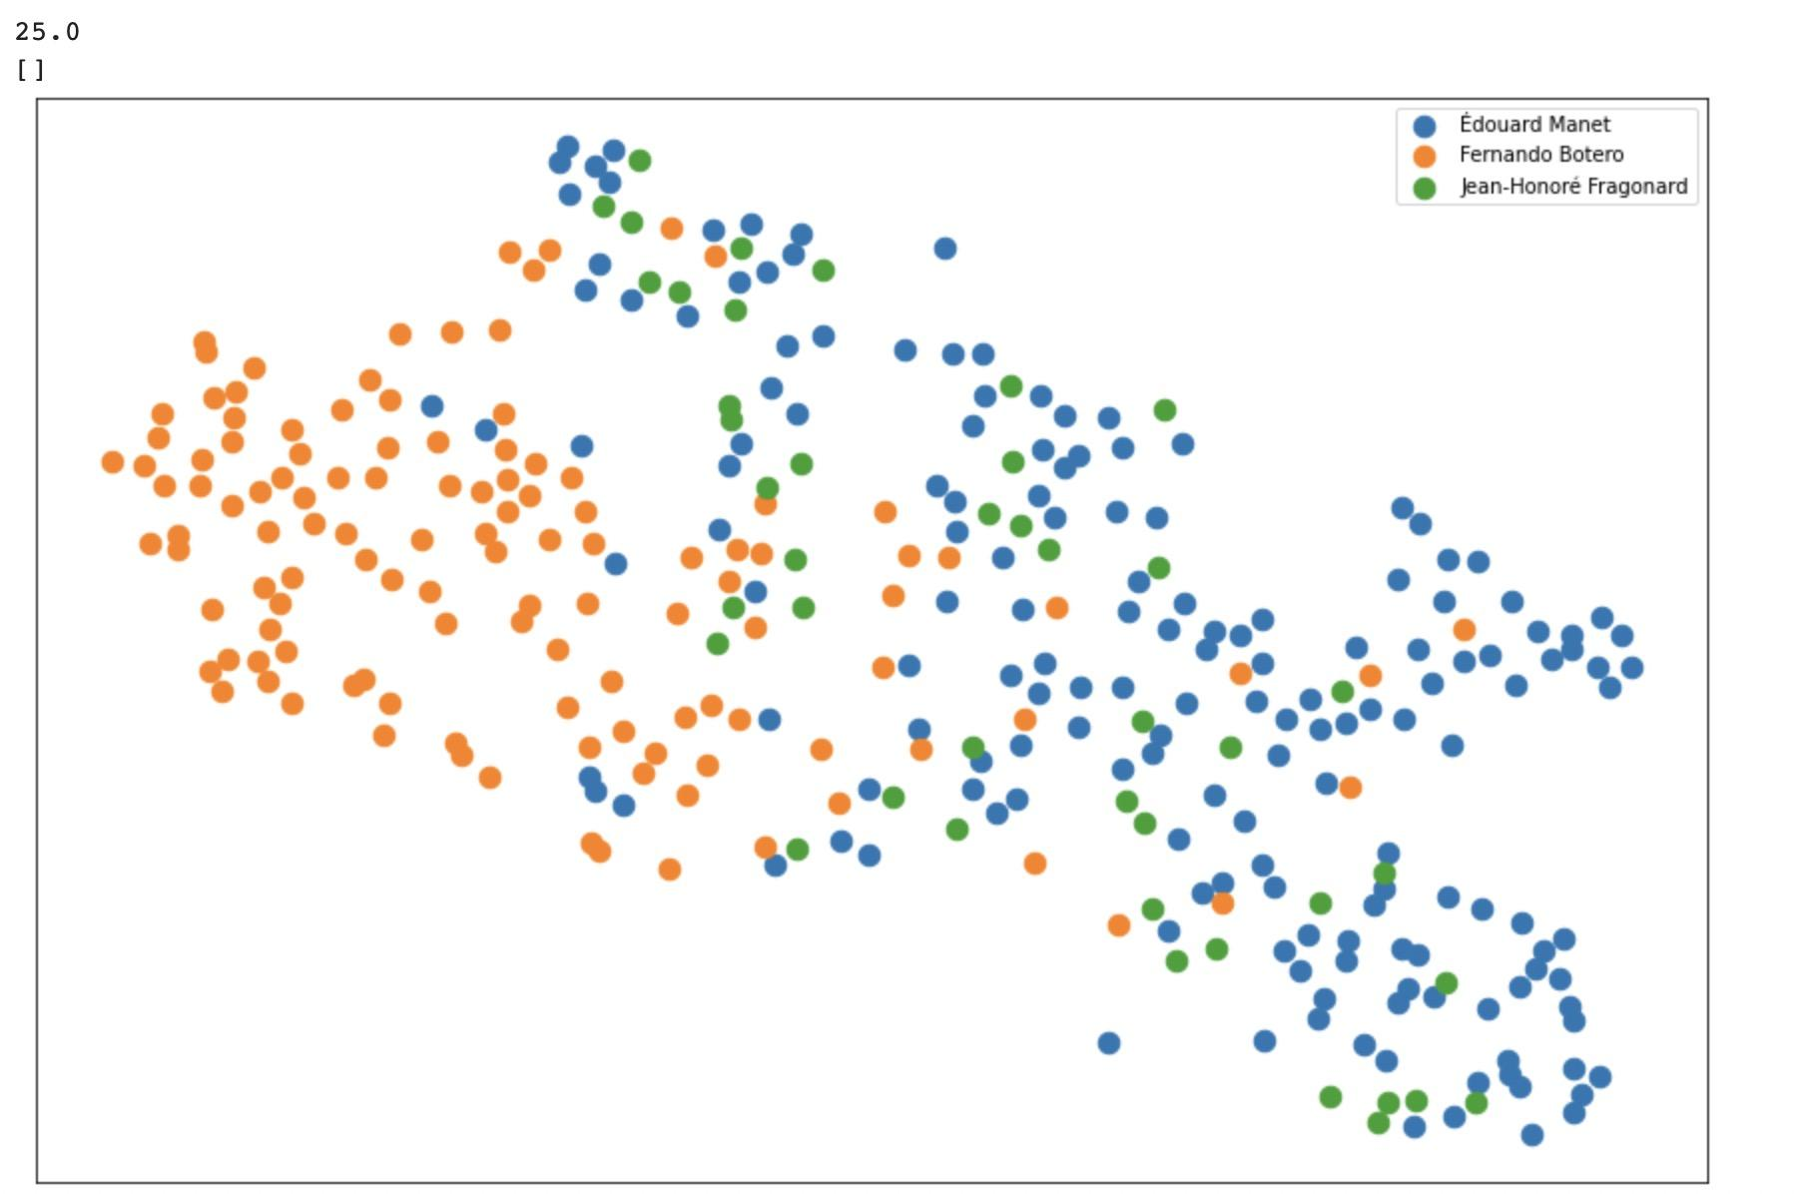
Perplexity = 25
t-SNE plotting of Manet, Botero and Fragonard with perplexity = 25

Slide 17
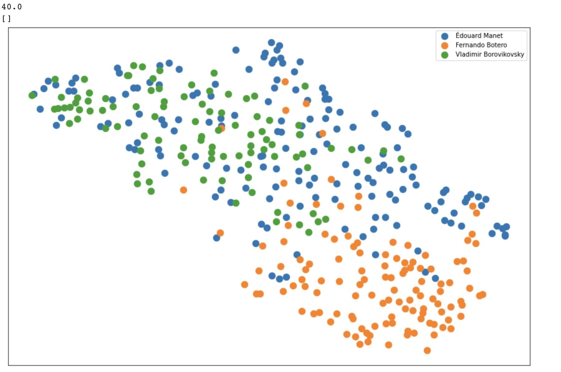
Perplexity = 40
t-SNE plotting of Manet, Botero and Borovikovsky with perplexity = 40 where we can see the strongest difference in style between Botero and Borovikovsky

Slide 18
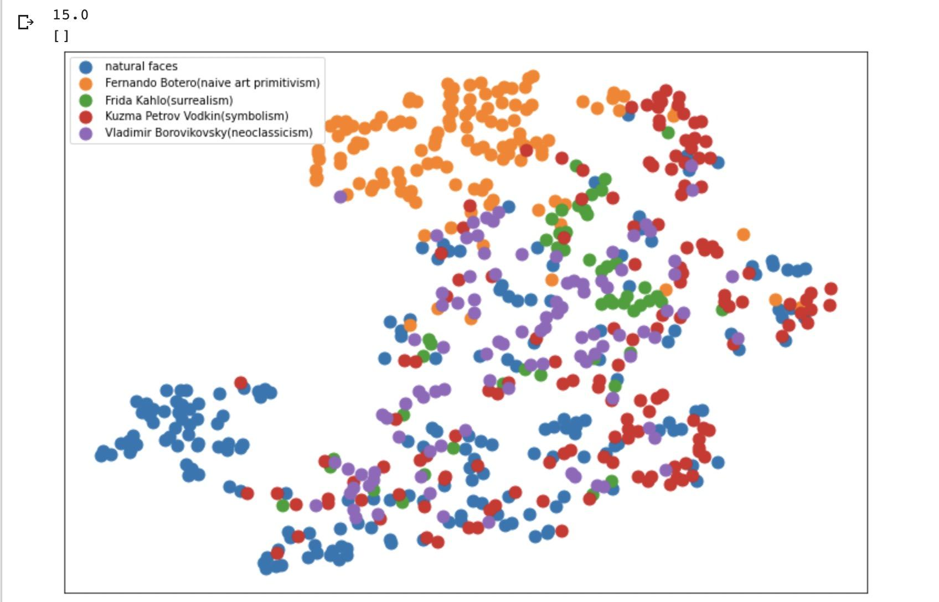
Comparison between artists and natural faces
Perplexity 15
t-SNE plotting of Kahlo, Botero, Vodkin, Borovikovsky and natural faces with perplexity = 15

Slide 19
Analysis on comparison included natural faces
Since in the training of dataset, we intentionally picked the natural faces dataset to be 21 year old characters that covers 188 faces in White, Asian and Black characters, thus:
the closer the correlation of similarity is between an artist’s dataset and the natural faces dataset, the more likely the artist is from a relatively more realistic in terms of being photogenic
the more clustered a specific cluster is, the more racially homogenized this artist’s characters are

Slide 20
Experiment Implications
Botero has a very unique artistic styles that differentiate clearly from almost every other style of art from a historical period, which make sense since Botero’s character are artistically coherent in primitivism art
Compared to Botero and Kahlo, most of the artists are from a period where their work are racially focused on white characters; and all artists from a more ancient data set has their characters mainly white character, which makes the data more racially homogenized and therefore creates denser plotting
Unless the artist’s has a coherently not too realistic style of portraits or the artist’s choice of race is relatively more diverse or different from the rules from the past
Interesting observation: most paintings we looked at did not overlap with a small cluster of natural faces(slide 18), it could be potentially used to understand the styles of the artists we selected.

Slide 21
Our Next Step
Our next step would be to use Machine Learning to do our second stream
We will be focusing on this stream as our next step

Slide 22
What to do next:
We want to try distinguishing different faces of the paintings using machine learning methods
We are planning on starting by dividing each dataset at a 8:2 ratio as for training and testing in our implementation for the second stream of our implementation.
We will select facial features from the dataset, determine importance of each feature, learning similarities between portrait pairs and compare the result after training

Slide 23
Thank you :)

